Slide 1
OOPs Introduction
1.4 Object Oriented Programming Object Oriented Programming is the most recent concept among programming model. The motivating factor in the invention of object oriented approach is to remove some of the flows encountered in the procedural approach. OOPS treats data as a critical element in the program development and does not allow it to flow freely around the system. It binds data more closely to the functions that operate on it, and protects it from accidental modification from outside functions. Some of the striking features of Object Oriented Programming are:
• Importance on data rather than procedure.
• Programs are divided into what are known as objects. Data structures are designed as such that they characterize the objects. Introduction to OOPs
• Functions that operate on the data of an object are tied together in the data structure.
• Data is hidden and cannot be accessed by external functions.
• Objects may communicate with each other through functions.
• New data and functions can be easily added whenever necessary.
• Follow bottom-up approach in program design.

Slide 2
Comparison of Procedural and Object Oriented Approach
There are two different approaches to write a program, i.e., Procedure Oriented Programming and Object Oriented Programming. Basic aim of these methods is nothing but to make programming efficient. We can write the program using any of the way but there are notable differences between both approaches.

Slide 3
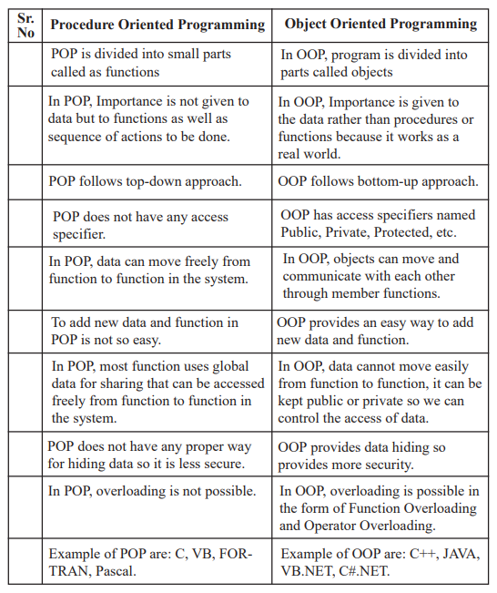
Comparisonof OOPs and Procedural Oriented Programming

Slide 4
Benefits of OOP
As OOP is closer to the real world phenomena, hence, it is easier to map real world problems onto a solution in OOP.
2) The objects in OOP have the state and behaviour that is similar to the real world objects.
3) It is more suitable for large projects.
4) The projects executed using OOP techniques are more reliable.
5) It provides the bases for increased testability (automated testing) and hence higher quality.
6) Abstraction techniques are used to hide the unnecessary details and focus is only on the relevant part of the problem and solution.
7) Encapsulation helps in concentrating the structure as well as the behaviour of various objects in OOP in a single enclosure.
8) The enclosure is also used to hide the information and to allow strictly controlled access to the structure as well as the behaviour of the objects.
9) OOP divides the problems into collection of objects to provide services for solving a particular problem.
10) Object oriented systems are easier to upgrade/modify.
11) The concepts like inheritance and polymorphism provide the extensibility of the OOP languages.
12) The concepts of OOP also enhance the reusability of the code written.
13) Software complexity can be better managed.
14) The use of the concept of message passing for communication among the objects makes the interface description with external system much simpler.
15) The maintainability of the programs or the software is increased manifold. If designed correctly, any tier of the application can be replaced by another provided the replaced tier implements the correct interface(s). The application will still work properly.

Slide 5
Advantages of OOPS
Code reusability in terms of inheritance.
Object-oriented system can be easily upgraded from one platform to another.
Complex projects can be easily divided into small code functions.
The principle of abstraction and encapsulation enables a programmer to build secure programs.
Software complexity decreases.
Principle of data hiding helps programmer to design and develop safe programs.
Rapid development of software can be done is short span of time.
More than one instance of same class can exist together without any interference.

Slide 6
Applications of OOPS
Object concept helps to translate our thoughts to a program. It provides a way of solving a problem in the same way as a human being perceives a real world problem and finds out the solution. It is possible to construct large reusable components using object-oriented techniques. Development of reusable components is rapidly growing in commercial software industries. If there is complexity in software development, object-oriented programming is the best paradigm to solve the problem. The following areas make the use of OOP:
1. Image Processing
2. Pattern Recognition
3. Computer Assisted Concurrent Engineering
4. Computer Aided Design and Manufacturing
5. Computer Aided Teaching
6. Intelligent Systems
7. Database Management Systems
8. Web-based Applications
9. Distributed Computing and Applications
10. Component-based Applications
11. Business Process Re-engineering
12. Enterprise Resource Planning
13. Data security and management
14. Mobile Computing
15. Data Warehouse and Data Mining
16. Parallel Computing

Slide 7
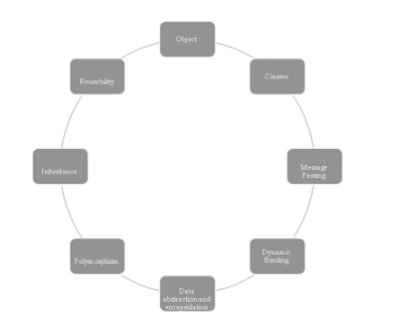
Features of OOPs
Object-Oriented Programming (OOP) in Python is based on the concept of objects that contain data and behavior. Some of the main features of OOP in Python include:
Abstraction
Hides the implementation details of an object from the user while still providing a simple interface
Encapsulation
Prevents clients from accessing certain properties, which can only be accessed through specific methods
Inheritance
A basic principle of OOP
Polymorphism
Allows objects of different classes to be treated as objects of a common class
These features make code more flexible, extensible, reusable, and easy to understand.0
Object
Classes
Polymorphism
Inheritance
Reusability
Data abstraction and encapsulation
Dynamic Binding ➢ Message Passing

Slide 8
Python - OOP Concepts
In the real world, we deal with and process objects, such as student, employee, invoice, car, etc. Objects are not only data and not only functions, but combination of both. Each real-world object has attributes and behavior associated with it.
Attributes
Name, class, subjects, marks, etc., of student
Name, designation, department, salary, etc., of employee
Invoice number, customer, product code and name, price and quantity, etc., in an invoice
Registration number, owner, company, brand, horsepower, speed, etc., of car
Each attribute will have a value associated with it. Attribute is equivalent to data.
Behavior
Processing attributes associated with an object.
Compute percentage of student's marks
Calculate incentives payable to employee
Apply GST to invoice value
Measure speed of car

Slide 9
Class & Object
A class is an user-defined prototype for an object that defines a set of attributes that characterize any object of the class. The attributes are data members (class variables and instance variables) and methods, accessed via dot notation.
An object refers to an instance of a certain class. For example, an object named obj that belongs to a class Circle is an instance of that class. A unique instance of a data structure that is defined by its class. An object comprises both data members (class variables and instance variables) and methods.
Example
The below example illustrates how to create a class and its object in Python.

Slide 10
Example
class GFG:
def __init__(self, name, company):
self.name = name
self.company = company
def show(self):
print("Hello my name is " + self.name+" and I" +
" work in "+self.company+".")
obj = GFG("John", "GeeksForGeeks")
obj.show()

Slide 11
# create a class
class Room:
length = 0.0
breadth = 0.0
# method to calculate area
def calculate_area(self):
print("Area of Room =", self.length * self.breadth)
# create object of Room class
study_room = Room()
# assign values to all the properties
study_room.length = 42.5
study_room.breadth = 30.8
# access method inside class
study_room.calculate_area()
Output
Area of Room = 1309.0

Slide 12
# define a class
class Bike:
name = ""
gear = 0
# create object of class
bike1 = Bike()
# access attributes and assign new values
bike1.gear = 11
bike1.name = "Mountain Bike"
print(f"Name: {bike1.name}, Gears: {bike1.gear} ")

Slide 13
Constructors in Python
In Python, a constructor is a special method that is called automatically when an object is created from a class. Its main role is to initialize the object by setting up its attributes or state.
__init__ Method
This method initializes the newly created instance and is commonly used as a constructor in Python. It is responsible for initializing attributes of the instance.
class ClassName:
def __init__(self, parameters):
self.attribute = value

Slide 14
Types of Constructors
Constructors can be of two types.
1. Default Constructor
A default constructor does not take any parameters other than self. It initializes the object with default attribute values.

Slide 15
Example
class Car:
def __init__(self):
#Initialize the Car with default attributes
self.make = "Toyota"
self.model = "Corolla"
self.year = 2020
# Creating an instance using the default constructor
car = Car()
print(car.make)
print(car.model)
print(car.year)
Output
Toyota
Corolla
2020

Slide 16
2. Parameterized Constructor
A parameterized constructor accepts arguments to initialize the object’s attributes with specific values.
class Car:
def __init__(self, make, model, year):
#Initialize the Car with specific attributes.
self.make = make
self.model = model
self.year = year
# Creating an instance using the parameterized constructor
car = Car("Honda", "Civic", 2022)
print(car.make)
print(car.model)
print(car.year)
Output
Honda
Civic
2020

Slide 17
Other Example
class Employee:
def __init__(self, name, id):
self.id = id
self.name = name
def display(self):
print("ID: %d \nName: %s" % (self.id, self.name))
emp1 = Employee("John", 101)
emp2 = Employee("David", 102)
# accessing display() method to print employee 1 information
emp1.display()
# accessing display() method to print employee 2 information
emp2.display()
Output
ID: 101
Name: John
ID: 102
Name: David

Slide 18
Destructors in Python
Destructors are called when an object gets destroyed. In Python, destructors are not needed as much as in C++ because Python has a garbage collector that handles memory management automatically.
The __del__() method is a known as a destructor method in Python. It is called when all references to the object have been deleted i.e when an object is garbage collected.
Syntax of destructor declaration :
def __del__(self):
# body of destructor
Note : A reference to objects is also deleted when the object goes out of reference or when the program ends.

Slide 19
class Employee:
# Initializing
def __init__(self):
print('Employee created.')
# Deleting (Calling destructor)
def __del__(self):
print('Destructor called, Employee deleted.')
obj = Employee()
del obj
Employee created.
Destructor called, Employee deleted.
Note : The destructor was called after the program ended or when all the references to object are deleted i.e when the reference count becomes zero, not when object went out of scope.

Slide 20
Self Variable in Python
the term “self” refers to the instance of the class that is currently being used. It is customary to use “self” as the first parameter in instance methods of a class. Whenever you call a method of an object created from a class, the object is automatically passed as the first argument using the “self” parameter. This enables you to modify the object’s properties and execute tasks unique to that particular instance.

Slide 21
Example
class Mynumber:
def __init__(self, value):
self.value = value
def print_value(self):
print(self.value)
obj1 = Mynumber(17)
obj1.print_value()
Output
17

Slide 22
The role of self in Python methods is to refer to the instance calling the method. It is how the method accesses the instance’s attributes and other methods. Without self, the method would not know which instance’s attributes to use.
Example:
class Circle:
def __init__(self, radius):
self.radius = radius
def area(self):
return 3.14 * self.radius ** 2
# Creating an instance of the Circle class
circle = Circle(5)
print(circle.area()) # Output: 78.5
Is self in Python a Keyword?
No, ‘ self ‘ is not a keyword in Python. Self is just a parameter name used in instance methods to refer to the instance itself.

Slide 23
Type Of Variable
TWO TYPES OF VARIABLES:
Global and Local
Local variables in Python are the ones that are defined and declared inside a function. We can not call this variable outside the function.
# This function uses local variable s
def f():
s = "Welcome Ismail yusuf college"
print(s)
f()
Output:
Welcome Ismail yusuf college

Slide 24
Global Variables: Global variables are variables that are declared outside of any function. They can be accessed and modified by any function within the same module.
e.g.
def f():
print(s)
# Global scope
s = "I love Python"
f()
Output:
I love Python

Slide 25
Rules of global keyword
If a variable is assigned a value anywhere within the function’s body, it’s assumed to be local unless explicitly declared as global.
Variables that are only referenced inside a function are implicitly global.
We use a global in Python to use a global variable inside a function.
There is no need to use a global keyword in Python outside a function.
Example:
x = 15
def change():
# using a global keyword
global x
# increment value of a by 5
x = x + 5
print("Value of x inside a function :", x)
change()
print("Value of x outside a function :", x)
Output:
Value of x inside a function : 20 Value of x outside a function : 20

Slide 26
Methods in Python
methods are functions that are associated with an object and can manipulate its data or perform actions on it. They are called using dot notation, with the object name followed by a period and the method name. Methods are an important part of object-oriented programming in Python.
Python offers various types of these methods. These are crucial to becoming an efficient programmer and consequently are useful for a data science professional.
Types of Methods in Python
There are basically three types of methods in Python:
Instance Method
Class Method
Static Method

Slide 27
1. Instance Methods
The purpose of instance methods is to set or get details about instances (objects), and that is why they’re known as instance methods. They are the most common type of methods used in a Python class.
They have one default parameter- self, which points to an instance of the class. Although you don’t have to pass that every time. You can change the name of this parameter but it is better to stick to the convention i.e self.
Any method you create inside a class is an instance method unless you specially specify Python otherwise.
Creating an Instance Method
Let’s see how to create an instance method:
class My_class:
def instance_method(self):
return "This is an instance method.“
In order to call an instance method, you’ve to create an object/instance of the class. With the help of this object, you can access any method of the class.
obj = My_class()
obj.instance_method()
Output:
This is an instance method
When the instance method is called, Python replaces the self argument with the instance object, obj. That is why we should add one default parameter while defining the instance methods. Notice that when instance_method() is called, you don’t have to pass self. Python does this for you.
Along with the default parameter self, you can add other parameters of your choice as well:
class My_class:
def instance_method(self, a):
return f"This is an instance method with a parameter a = {a}.“
We have an additional parameter “a” here. Now let’s create the object of the class and call this instance method:
obj = My_class()
obj.instance_method(10)
Output:
This is an instance method with a parameter a =10

Slide 28
2. Class Methods
The purpose of the class methods is to set or get the details (status) of the class. That is why they are known as class methods. They can’t access or modify specific instance data. They are bound to the class instead of their objects. Two important things about class methods:
In order to define a class method, you have to specify that it is a class method with the help of the @classmethod decorator
Class methods also take one default parameter- cls, which points to the class. Again, this not mandatory to name the default parameter “cls”. But it is always better to go with the conventions
Now let’s look at how to create class methods:
class My_class:
@classmethod
def class_method(cls):
return "This is a class method.“
Output:
This is a class method.

Slide 29
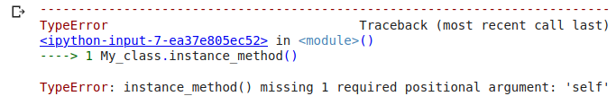
This works too!
We can access the class methods with the help of a class instance/object. But we can access the class methods directly without creating an instance or object of the class. Let’s see how:
As I said earlier, with the help of the instance of the class, you can access any method. So we’ll create the instance of this My_class as well and try calling this class_method():
obj = My_class()
obj.class_method()
My_class.class_method()
Output:
This is a class method
Without creating an instance of the class, you can call the class method with – Class_name.Method_name().
But this is not possible with instance methods where we have to create an instance of the class in order to call instance methods. Let’s see what happens when we try to call the instance method directly:
My_class.instance_method()
We got an error stating missing one positional argument – “self”. And it is obvious because instance methods accept an instance of the class as the default parameter. And you are not providing any instance as an argument. Though this can be bypassing the object name as the argument:
My_class.instance_method(obj)
Output
This is a class method

Slide 30
3. Static Methods
Static methods cannot access the class data. In other words, they do not need to access the class data. They are self-sufficient and can work on their own. Since they are not attached to any class attribute, they cannot get or set the instance state or class state.
In order to define a static method, we can use the @staticmethod decorator (in a similar way we used @classmethod decorator). Unlike instance methods and class methods, we do not need to pass any special or default parameters. Let’s look at the implementation:
class My_class:
@staticmethod
def static_method():
return "This is a static method.”
Notice that we do not have any default parameter in this case. Now how do we call static methods? Again, we can call them using object/instance of the class as:
obj = My_class()
obj.static_method()
Output:
This is a static method
And we can call static methods directly, without creating an object/instance of the class:
My_class.static_method()
Output:
This is a static method
You can notice the output is the same using both ways of calling static methods.
Here’s a summary of the explanation we’ve seen:
An instance method knows its instance (and from that, it’s class)
A class method knows its class
A static method doesn’t know its class or instance

Slide 31
What is Calling a Class Method From Another Class?
Calling a class method from another class refers to the process of invoking a method defined in one class from within a different class. This capability enhances code organization and promotes the reuse of existing functionality. Python provides a straightforward syntax for achieving this, allowing developers to create modular and maintainable code.
Call A Class Method From Another Class In Python
Below, are the example of Call A Class Method From Another Class In Python
Example 1: Simple Class Method Call
Let's consider a scenario where we have two classes, ClassA and ClassB. We want to call a method of ClassA from within ClassB. Here's how you can achieve this: In this example, ClassB has a method called call_method_from_class_a, and within this method, we call the method_in_class_a of ClassA using ClassA.method_in_class_a().
class ClassA:
@staticmethod
def method_in_class_a():
print("Method in ClassA")
class ClassB:
def call_method_from_class_a(self):
ClassA.method_in_class_a()
print("Method in ClassB")
# Create an instance of ClassB
obj_b = ClassB() # Call the method in ClassB, which in turn calls the method in ClassA
obj_b.call_method_from_class_a()
Output:
Method in ClassA
Method in ClassB

Slide 32
Example 2: Passing an Instance of another Class
Another approach is to create an instance of the class whose method you want to call and then invoke the method on that instance. Let's illustrate this with an example: In this example, ClassY creates an instance of ClassX within its call_method_from_class_x method and then calls the method of ClassX.
Example:
class ClassX:
def method_in_class_x(self):
print("Method in ClassX")
class ClassY:
def call_method_from_class_x(self):
instance_x = ClassX()
instance_x.method_in_class_x()
print("Method in ClassY")
# Create an instance of ClassY
obj_y = ClassY()
# Call the method in ClassY, which in turn creates an instance of ClassX and calls its method
obj_y.call_method_from_class_x()
Output:
Method in ClassX
Method in ClassY

Slide 33
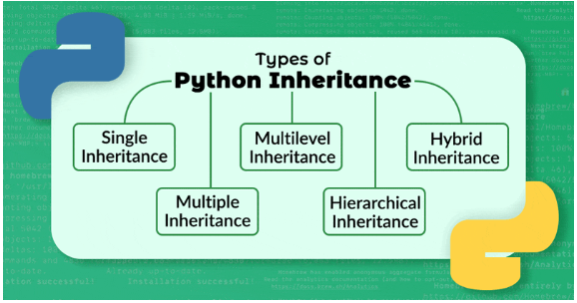
Inheritance
Inheritance is defined as the mechanism of inheriting the properties of the base class to the child class

Slide 34
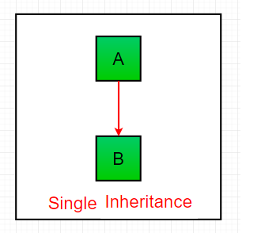
Single Inheritance:
Single inheritance enables a derived class to inherit properties from a single parent class, thus enabling code reusability and the addition of new features to existing code.
# Base class
class Parent:
def func1(self):
print("This function is in parent class.")
# Derived class
class Child(Parent):
def func2(self):
print("This function is in child class.")
# Driver's code
object = Child()
object.func1()
object.func2()
Output:
This function is in parent class.
This function is in child class.

Slide 35
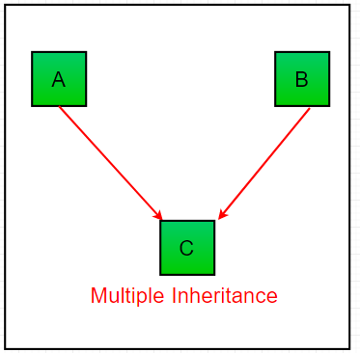
Multiple Inheritance:
When a class can be derived from more than one base class this type of inheritance is called multiple inheritances. In multiple inheritances, all the features of the base classes are inherited into the derived class.
# Base class1
class Mother:
mothername = ""
def mother(self):
print(self.mothername)
# Base class2
class Father:
fathername = ""
def father(self):
print(self.fathername)
# Derived class
class Son(Mother, Father):
def parents(self):
print("Father :", self.fathername)
print("Mother :", self.mothername)
# Driver's code
s1 = Son()
s1.fathername = "RAM"
s1.mothername = "SITA"
s1.parents()
Output:
Father : RAM
Mother : SITA

Slide 36
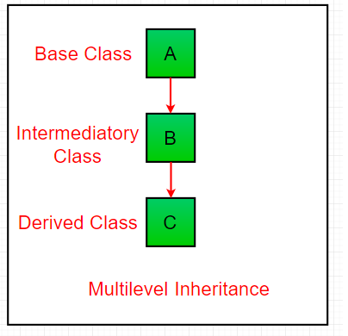
Multilevel Inheritance :
In multilevel inheritance, features of the base class and the derived class are further inherited into the new derived class. This is similar to a relationship representing a child and a grandfather.
# Base class
class Grandfather:
def __init__(self, grandfathername):
self.grandfathername = grandfathername
# Intermediate class
class Father(Grandfather):
def __init__(self, fathername, grandfathername):
self.fathername = fathername
# invoking constructor of Grandfather class
Grandfather.__init__(self, grandfathername)
# Derived class
class Son(Father):
def __init__(self, sonname, fathername, grandfathername):
self.sonname = sonname
# invoking constructor of Father class
Father.__init__(self, fathername, grandfathername)
def print_name(self):
print('Grandfather name :', self.grandfathername)
print("Father name :", self.fathername)
print("Son name :", self.sonname)
# Driver code
s1 = Son('Prince', 'Rampal', 'Lal mani')
print(s1.grandfathername)
s1.print_name()
Output
Lal mani
Grandfather name : Lal mani
Father name : Rampal
Son name : Prince

Slide 37
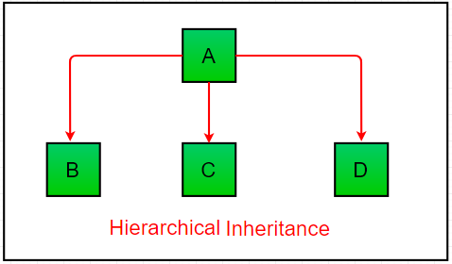
Hierarchical Inheritance:
When more than one derived class are created from a single base this type of inheritance is called hierarchical inheritance. In this program, we have a parent (base) class and two child (derived) classes.
# Base class
class Parent:
def func1(self):
print("This function is in parent class.")
# Derived class1
class Child1(Parent):
def func2(self):
print("This function is in child 1.")
# Derivied class2
class Child2(Parent):
def func3(self):
print("This function is in child 2.")
# Driver's code
object1 = Child1()
object2 = Child2()
object1.func1()
object1.func2()
object2.func1()
object2.func3()
Output
This function is in parent class.
This function is in child 1.
This function is in parent class.
This function is in child 2.

Slide 38
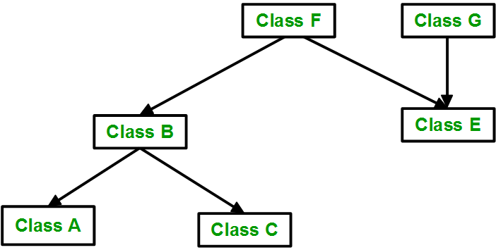
Hybrid Inheritance:
Inheritance consisting of multiple types of inheritance is called hybrid inheritance.
class School:
def func1(self):
print("This function is in school.")
class Student1(School):
def func2(self):
print("This function is in student 1. ")
class Student2(School):
def func3(self):
print("This function is in student 2.")
class Student3(Student1, School):
def func4(self):
print("This function is in student 3.")
# Driver's code
object = Student3()
object.func1()
object.func2()
Output:
This function is in school.
This function is in student 1.

Slide 39
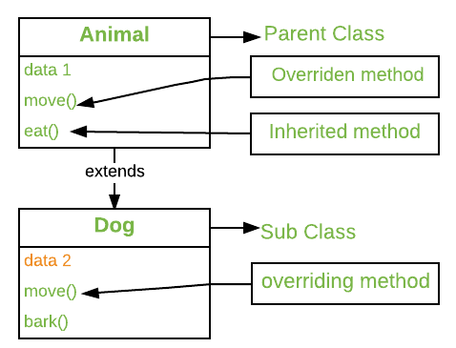
Method Overriding in Python
Method overriding is an ability of any object-oriented programming language that allows a subclass or child class to provide a specific implementation of a method that is already provided by one of its super-classes or parent classes. When a method in a subclass has the same name, the same parameters or signature, and same return type(or sub-type) as a method in its super-class, then the method in the subclass is said to override the method in the super-class.

Slide 40
The version of a method that is executed will be determined by the object that is used to invoke it. If an object of a parent class is used to invoke the method, then the version in the parent class will be executed, but if an object of the subclass is used to invoke the method, then the version in the child class will be executed. In other words, it is the type of the object being referred to (not the type of the reference variable) that determines which version of an overridden method will be executed.
Example:
super().__init__(): This ensures that the parent class’s constructor is called, initializing any attributes defined in the parent class. It’s good practice to call the parent class constructor if it does important initialization.
Method Override: The Child class overrides the show() method of the Parent class, so when show() is called on an instance of Child, it uses the Child class’s implementation.

Slide 41
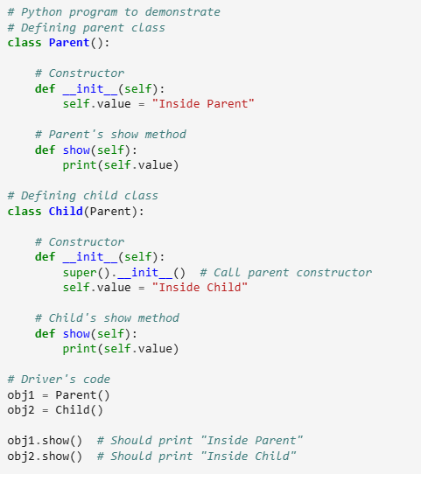
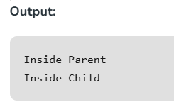

Slide 42
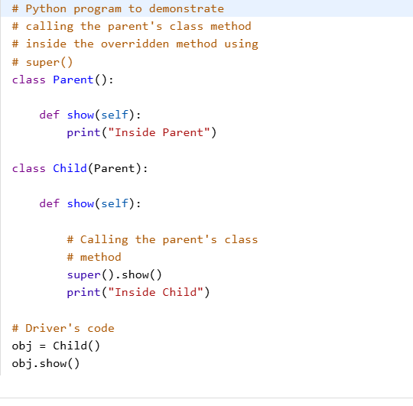

super() method
Using Super()
Python super() function provides us the facility to refer to the parent class explicitly. It is basically useful where we have to call superclass functions. It returns the proxy object that allows us to refer parent class by ‘super’.

Slide 43
What is polymorphism?
Polymorphism is made up of the word’s “poly” and “morphs”. Poly stands for “many” and Morph stands for “Shape”. Polymorphism refers to having multiple forms. Polymorphism is a programming term that refers to the use of the same function name, but with different signatures, for multiple types.
Example
class Dog():
def animal_kingdom(self):
print("Mammal")
def legs(self):
print("Four")
class Lizard():
def animal_kingdom(self):
print("Mammal")
def legs(self):
print("Four")
def function1(obj):
obj.animal_kingdom()
obj.legs()
obj_dog = Dog()
obj_lizard = Lizard()
function1(obj_dog)
function1(obj_lizard)
Output
Mammal
Four
Mammal
Four

Slide 44
Duck Type
Earlier, we have discussed that Python is a dynamic typed language. However, we can use the dynamic approach with custom data types. Let's understand the following example:
class VisualStudio: def execute(self): print('Compiling') print('Running') print('Spell Check') print('Convention Check') class Desktop: def code(self, ide): ide.execute() ide = VisualStudio() desk = Desktop() desk.code(ide) Output: Compiling Running Spell Check Convention Check | class Duck: def swim(self): print("I'm a duck, and I can swim.") class Sparrow: def swim(self): print("I'm a sparrow, and I can swim.") class Crocodile: def swim_walk(self): print("I'm a Crocodile, and I can swim, but not quack.") def duck_testing(animal): animal.swim() duck_testing(Duck()) duck_testing(Sparrow()) duck_testing(Crocodile())

Slide 45
Operator Overloading in Python
Operator Overloading means giving extended meaning beyond their predefined operational meaning. For example operator + is used to add two integers as well as join two strings and merge two lists. It is achievable because ‘+’ operator is overloaded by int class and str class. You might have noticed that the same built-in operator or function shows different behavior for objects of different classes, this is called Operator Overloading.
Example:
class A:
def __init__(self, a):
self.a = a
# adding two objects
def __add__(self, o):
return self.a + o.a
ob1 = A(1)
ob2 = A(2)
ob3 = A("Geeks")
ob4 = A("For")
print(ob1 + ob2)
print(ob3 + ob4)
print(A.__add__(ob1 , ob2))
print(A.__add__(ob3,ob4))
print(ob1.__add__(ob2))
print(ob3.__add__(ob4))
Output
3
GeeksFor
3
GeeksFor
3
GeeksFor
Here, We defined the special function “__add__( )” and when the objects ob1 and ob2 are coded as “ob1 + ob2“, the special function is automatically called as ob1.__add__(ob2) which simply means that ob1 calls the __add__( ) function with ob2 as an Argument and It actually means A .__add__(ob1, ob2). Hence, when the Binary operator is overloaded, the object before the operator calls the respective function with object after operator as parameter.

Slide 46
Method Overloading
Method overloading is a feature of object-oriented programming where a class can have multiple methods with the same name but different parameters. To overload method, we must change the number of parameters or the type of parameters, or both.
class example with Error: def add(self, a, b): x = a+b return x def add(self, a, b, c): x = a+b+c return x obj = example() print (obj.add(10,20,30)) print (obj.add(10,20)) Output with Error 60 Traceback (most recent call last): File "C:\Users\user\example.py", line 12, in <module> print (obj.add(10,20)) ^^^^^^^^^^^^^^ TypeError: example.add() missing 1 required positional argument: 'c' | class example: def add(self, a = None, b = None, c = None): x=0 if a !=None and b != None and c != None: x = a+b+c elif a !=None and b != None and c == None: x = a+b return x obj = example() print (obj.add(10,20,30)) print (obj.add(10,20)) OUTPUT 60 30

Slide 47
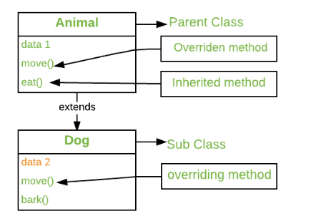
Method Overriding
Method overriding is an ability of any object-oriented programming language that allows a subclass or child class to provide a specific implementation of a method that is already provided by one of its super-classes or parent classes. When a method in a subclass has the same name, the same parameters or signature, and same return type(or sub-type) as a method in its super-class, then the method in the subclass is said to override the method in the super-class.
The version of a method that is executed will be determined by the object that is used to invoke it. If an object of a parent class is used to invoke the method, then the version in the parent class will be executed, but if an object of the subclass is used to invoke the method, then the version in the child class will be executed. In other words, it is the type of the object being referred to (not the type of the reference variable) that determines which version of an overridden method will be executed.

Slide 48
The Child class overrides the show() method of the Parent class, so when show() is called on an instance of Child, it uses the Child class’s implementation.
# Python program to demonstrate # Defining parent class class Parent(): # Constructor def __init__(self): self.value = "Inside Parent" # Parent's show method def show(self): print(self.value) # Defining child class class Child(Parent): # Constructor def __init__(self): super().__init__() # Call parent constructor self.value = "Inside Child" # Child's show method def show(self): print(self.value) # Driver's code obj1 = Parent() obj2 = Child() obj1.show() # Should print "Inside Parent" obj2.show() # Should print "Inside Child" | Output Inside Parent Inside Child

